Slide 1
Chapter 8: Main Memory

Slide 2
Chapter 8: Memory Management
Background
Swapping
Contiguous Memory Allocation
Segmentation
Paging
Structure of the Page Table
Example: The Intel 32 and 64-bit Architectures
Example: ARM Architecture

Slide 3
Background
Program must be brought (from disk) into memory and placed within a process for it to be run
Main memory and registers are only storage CPU can access directly
Memory unit only sees a stream of addresses + read requests, or address + data and write requests
Register access in one CPU clock (or less)
Main memory can take many cycles, causing a stall
Cache sits between main memory and CPU registers
Protection of memory required to ensure correct operation

Slide 4
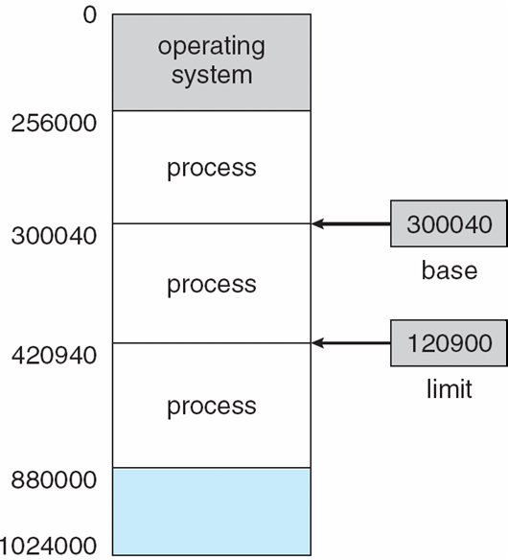
Base and Limit Registers
A pair of base and limit registers define the logical address space
CPU must check every memory access generated in user mode to be sure it is between base and limit for that user

Slide 5
Hardware Address Protection

Slide 6
Address Binding
Programs on disk, ready to be brought into memory to execute form an input queue
Without support, must be loaded into address 0000
Inconvenient to have first user process physical address always at 0000
How can it not be?
Further, addresses represented in different ways at different stages of a program’s life
Source code addresses usually symbolic
Compiled code addresses bind to relocatable addresses
i.e. “14 bytes from beginning of this module”
Linker or loader will bind relocatable addresses to absolute addresses
i.e. 74014
Each binding maps one address space to another

Slide 7
Binding of Instructions and Data to Memory
Address binding of instructions and data to memory addresses can happen at three different stages
Compile time: If memory location known a priori, absolute code can be generated; must recompile code if starting location changes
Load time: Must generate relocatable code if memory location is not known at compile time
Execution time: Binding delayed until run time if the process can be moved during its execution from one memory segment to another
Need hardware support for address maps (e.g., base and limit registers)

Slide 8
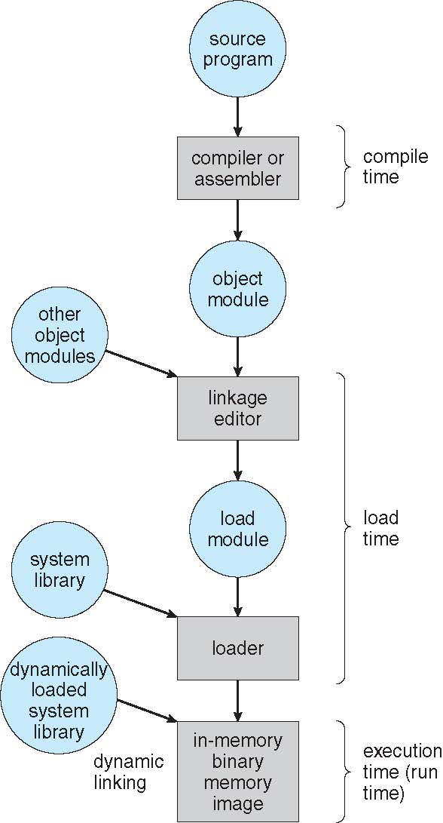
Multistep Processing of a User Program

Slide 9
Logical vs. Physical Address Space
The concept of a logical address space that is bound to a separate physical address space is central to proper memory management
Logical address – generated by the CPU; also referred to as virtual address
Physical address – address seen by the memory unit
Logical and physical addresses are the same in compile-time and load-time address-binding schemes; logical (virtual) and physical addresses differ in execution-time address-binding scheme
Logical address space is the set of all logical addresses generated by a program
Physical address space is the set of all physical addresses generated by a program

Slide 10
Memory-Management Unit (MMU)
Hardware device that at run time maps virtual to physical address
Many methods possible, covered in the rest of this chapter
To start, consider simple scheme where the value in the relocation register is added to every address generated by a user process at the time it is sent to memory
Base register now called relocation register
MS-DOS on Intel 80x86 used 4 relocation registers
The user program deals with logical addresses; it never sees the real physical addresses
Execution-time binding occurs when reference is made to location in memory
Logical address bound to physical addresses

Slide 11
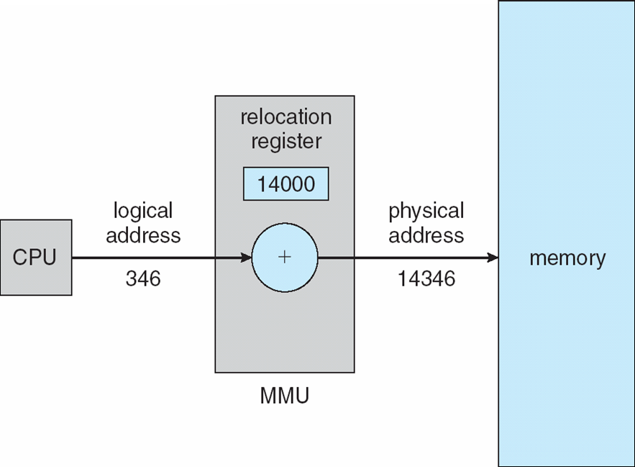
Dynamic relocation using a relocation register
Routine is not loaded until it is called
Better memory-space utilization; unused routine is never loaded
All routines kept on disk in relocatable load format
Useful when large amounts of code are needed to handle infrequently occurring cases
No special support from the operating system is required
Implemented through program design
OS can help by providing libraries to implement dynamic loading

Slide 12
Dynamic Linking
Static linking – system libraries and program code combined by the loader into the binary program image
Dynamic linking –linking postponed until execution time
Small piece of code, stub, used to locate the appropriate memory-resident library routine
Stub replaces itself with the address of the routine, and executes the routine
Operating system checks if routine is in processes’ memory address
If not in address space, add to address space
Dynamic linking is particularly useful for libraries
System also known as shared libraries
Consider applicability to patching system libraries
Versioning may be needed

Slide 13
Swapping
A process can be swapped temporarily out of memory to a backing store, and then brought back into memory for continued execution
Total physical memory space of processes can exceed physical memory
Backing store – fast disk large enough to accommodate copies of all memory images for all users; must provide direct access to these memory images
Roll out, roll in – swapping variant used for priority-based scheduling algorithms; lower-priority process is swapped out so higher-priority process can be loaded and executed
Major part of swap time is transfer time; total transfer time is directly proportional to the amount of memory swapped
System maintains a ready queue of ready-to-run processes which have memory images on disk

Slide 14
Swapping (Cont.)
Does the swapped out process need to swap back in to same physical addresses?
Depends on address binding method
Plus consider pending I/O to / from process memory space
Modified versions of swapping are found on many systems (i.e., UNIX, Linux, and Windows)
Swapping normally disabled
Started if more than threshold amount of memory allocated
Disabled again once memory demand reduced below threshold

Slide 15

Schematic View of Swapping

Slide 16
Context Switch Time including Swapping
If next processes to be put on CPU is not in memory, need to swap out a process and swap in target process
Context switch time can then be very high
100MB process swapping to hard disk with transfer rate of 50MB/sec
Swap out time of 2000 ms
Plus swap in of same sized process
Total context switch swapping component time of 4000ms (4 seconds)
Can reduce if reduce size of memory swapped – by knowing how much memory really being used
System calls to inform OS of memory use via request_memory() and release_memory()

Slide 17
Context Switch Time and Swapping (Cont.)
Other constraints as well on swapping
Pending I/O – can’t swap out as I/O would occur to wrong process
Or always transfer I/O to kernel space, then to I/O device
Known as double buffering, adds overhead
Standard swapping not used in modern operating systems
But modified version common
Swap only when free memory extremely low

Slide 18
Swapping on Mobile Systems
Not typically supported
Flash memory based
Small amount of space
Limited number of write cycles
Poor throughput between flash memory and CPU on mobile platform
Instead use other methods to free memory if low
iOS asks apps to voluntarily relinquish allocated memory
Read-only data thrown out and reloaded from flash if needed
Failure to free can result in termination
Android terminates apps if low free memory, but first writes application state to flash for fast restart
Both OSes support paging as discussed below

Slide 19
Contiguous Allocation
Main memory must support both OS and user processes
Limited resource, must allocate efficiently
Contiguous allocation is one early method
Main memory usually into two partitions:
Resident operating system, usually held in low memory with interrupt vector
User processes then held in high memory
Each process contained in single contiguous section of memory

Slide 20
Contiguous Allocation (Cont.)
Relocation registers used to protect user processes from each other, and from changing operating-system code and data
Base register contains value of smallest physical address
Limit register contains range of logical addresses – each logical address must be less than the limit register
MMU maps logical address dynamically
Can then allow actions such as kernel code being transient and kernel changing size

Slide 21

Hardware Support for Relocation and Limit Registers

Slide 22
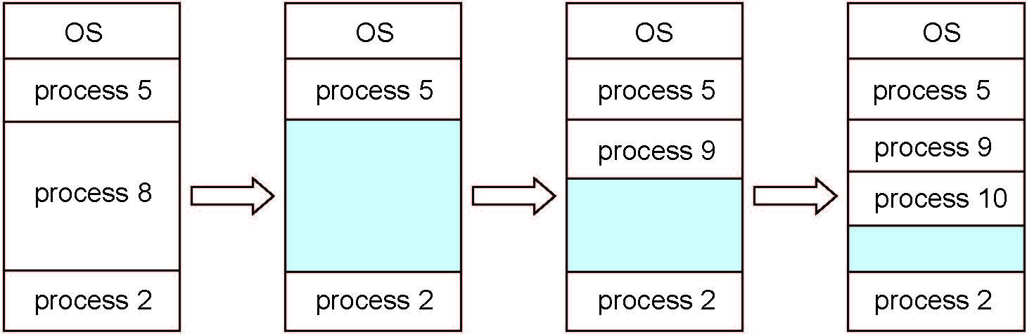
Multiple-partition allocation
Multiple-partition allocation
Degree of multiprogramming limited by number of partitions
Variable-partition sizes for efficiency (sized to a given process’ needs)
Hole – block of available memory; holes of various size are scattered throughout memory
When a process arrives, it is allocated memory from a hole large enough to accommodate it
Process exiting frees its partition, adjacent free partitions combined
Operating system maintains information about: a) allocated partitions b) free partitions (hole)

Slide 23
Dynamic Storage-Allocation Problem
How to satisfy a request of size n from a list of free holes?
First-fit: Allocate the first hole that is big enough
Best-fit: Allocate the smallest hole that is big enough; must search entire list, unless ordered by size
Produces the smallest leftover hole
Worst-fit: Allocate the largest hole; must also search entire list
Produces the largest leftover hole
First-fit and best-fit better than worst-fit in terms of speed and storage utilization

Slide 24
Fragmentation
External Fragmentation – total memory space exists to satisfy a request, but it is not contiguous
Internal Fragmentation – allocated memory may be slightly larger than requested memory; this size difference is memory internal to a partition, but not being used
First fit analysis reveals that given N blocks allocated, 0.5 N blocks lost to fragmentation
1/3 may be unusable -> 50-percent rule

Slide 25
Fragmentation (Cont.)
Reduce external fragmentation by compaction
Shuffle memory contents to place all free memory together in one large block
Compaction is possible only if relocation is dynamic, and is done at execution time
I/O problem
Latch job in memory while it is involved in I/O
Do I/O only into OS buffers
Now consider that backing store has same fragmentation problems

Slide 26
Segmentation
Memory-management scheme that supports user view of memory
A program is a collection of segments
A segment is a logical unit such as:
main program
procedure
function
method
object
local variables, global variables
common block
stack
symbol table
arrays

Slide 27
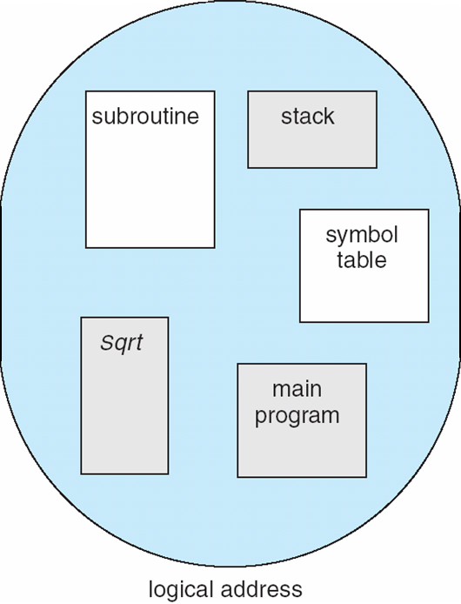
User’s View of a Program

Slide 28
Logical View of Segmentation
1
1
4
2
3
4
2
3
user space
physical memory space

Slide 29
Segmentation Architecture
Logical address consists of a two tuple:
<segment-number, offset>,
Segment table – maps two-dimensional physical addresses; each table entry has:
base – contains the starting physical address where the segments reside in memory
limit – specifies the length of the segment
Segment-table base register (STBR) points to the segment table’s location in memory
Segment-table length register (STLR) indicates number of segments used by a program;
segment number s is legal if s < STLR

Slide 30
Segmentation Architecture (Cont.)
Protection
With each entry in segment table associate:
validation bit = 0 ⇒ illegal segment
read/write/execute privileges
Protection bits associated with segments; code sharing occurs at segment level
Since segments vary in length, memory allocation is a dynamic storage-allocation problem
A segmentation example is shown in the following diagram

Slide 31
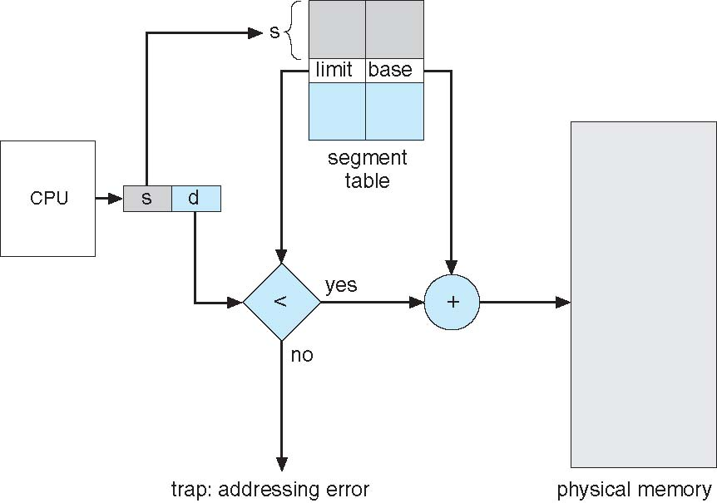
Segmentation Hardware

Slide 32
Paging
Physical address space of a process can be noncontiguous; process is allocated physical memory whenever the latter is available
Avoids external fragmentation
Avoids problem of varying sized memory chunks
Divide physical memory into fixed-sized blocks called frames
Size is power of 2, between 512 bytes and 16 Mbytes
Divide logical memory into blocks of same size called pages
Keep track of all free frames
To run a program of size N pages, need to find N free frames and load program
Set up a page table to translate logical to physical addresses
Backing store likewise split into pages
Still have Internal fragmentation

Slide 33
Address Translation Scheme
Address generated by CPU is divided into:
Page number (p) – used as an index into a page table which contains base address of each page in physical memory
Page offset (d) – combined with base address to define the physical memory address that is sent to the memory unit
For given logical address space 2^{m} and page size 2^{n}

Slide 34
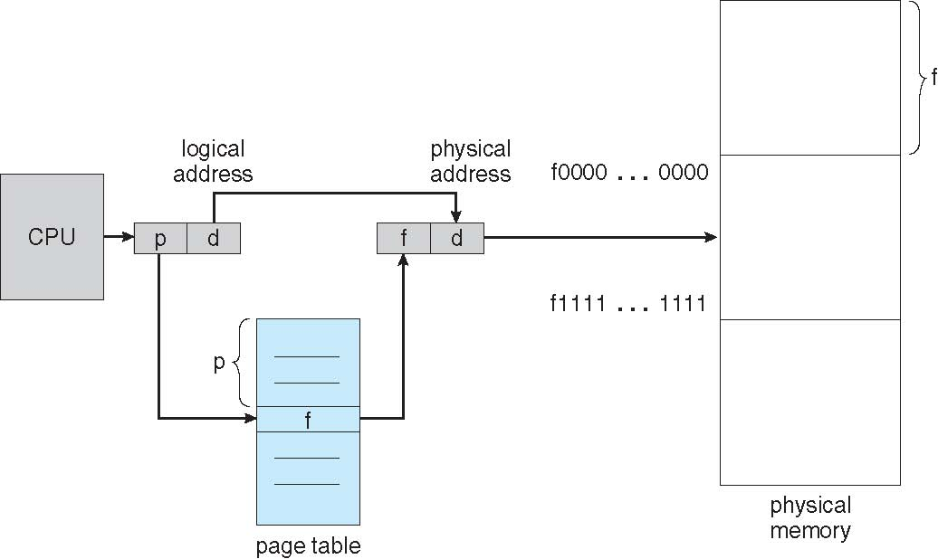
Paging Hardware

Slide 35

Paging Model of Logical and Physical Memory

Slide 36

Paging Example
n=2 and m=4 32-byte memory and 4-byte pages

Slide 37
Paging (Cont.)
Calculating internal fragmentation
Page size = 2,048 bytes
Process size = 72,766 bytes
35 pages + 1,086 bytes
Internal fragmentation of 2,048 - 1,086 = 962 bytes
Worst case fragmentation = 1 frame – 1 byte
On average fragmentation = 1 / 2 frame size
So small frame sizes desirable?
But each page table entry takes memory to track
Page sizes growing over time
Solaris supports two page sizes – 8 KB and 4 MB
Process view and physical memory now very different
By implementation process can only access its own memory

Slide 38

Free Frames
Before allocation
After allocation

Slide 39
Implementation of Page Table
Page table is kept in main memory
Page-table base register (PTBR) points to the page table
Page-table length register (PTLR) indicates size of the page table
In this scheme every data/instruction access requires two memory accesses
One for the page table and one for the data / instruction
The two memory access problem can be solved by the use of a special fast-lookup hardware cache called associative memory or translation look-aside buffers (TLBs)

Slide 40
Implementation of Page Table (Cont.)
Some TLBs store address-space identifiers (ASIDs) in each TLB entry – uniquely identifies each process to provide address-space protection for that process
Otherwise need to flush at every context switch
TLBs typically small (64 to 1,024 entries)
On a TLB miss, value is loaded into the TLB for faster access next time
Replacement policies must be considered
Some entries can be wired down for permanent fast access

Slide 41
Associative Memory
Associative memory – parallel search
Address translation (p, d)
If p is in associative register, get frame # out
Otherwise get frame # from page table in memory

Slide 42

Paging Hardware With TLB

Slide 43
Effective Access Time
Associative Lookup = ε time unit
Can be < 10% of memory access time
Hit ratio = α
Hit ratio – percentage of times that a page number is found in the associative registers; ratio related to number of associative registers
Consider α = 80%, T_{L} = 20ns for TLB search, T_{M} =100ns for memory access
Effective Access Time (EAT) [parallel accesses to TLB and page table]
EAT = α(T_{L} + T_{M}) + (1 – α)(T_{M} + T_{M})
Consider α = 80%, ε = 20ns for TLB search, 100ns for memory access
EAT = 0.80 x (20+100) + 0.20 x (100 +100) = 136ns
Consider more realistic hit ratio -> α = 99%, ε = 20ns for TLB search, 100ns for memory access
EAT = 0.99 x 120 + 0.01 x 200 = 120.8ns

Slide 44
Memory Protection
Memory protection implemented by associating protection bit with each frame to indicate if read-only or read-write access is allowed
Can also add more bits to indicate page execute-only, and so on
Valid-invalid bit attached to each entry in the page table:
“valid” indicates that the associated page is in the process’ logical address space, and is thus a legal page
“invalid” indicates that the page is not in the process’ logical address space
Or use page-table length register (PTLR)
Any violations result in a trap to the kernel

Slide 45

Valid (v) or Invalid (i) Bit In A Page Table

Slide 46
Shared Pages
Shared code
One copy of read-only (reentrant) code shared among processes (i.e., text editors, compilers, window systems)
Similar to multiple threads sharing the same process space
Also useful for interprocess communication if sharing of read-write pages is allowed
Private code and data
Each process keeps a separate copy of the code and data
The pages for the private code and data can appear anywhere in the logical address space

Slide 47
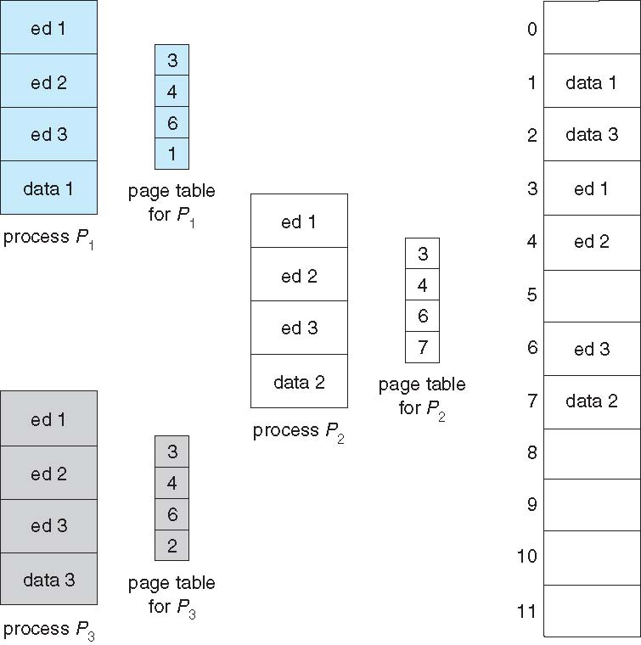
Shared Pages Example

Slide 48
Structure of the Page Table
Memory structures for paging can get huge using straight-forward methods
Consider a 32-bit logical address space as on modern computers
Page size of 4 KB (2¹²)
Page table would have 1 million entries (2³² / 2¹²)
If each entry is 4 bytes -> 4 MB of physical address space / memory for page table alone
That amount of memory used to cost a lot
Don’t want to allocate that contiguously in main memory
Hierarchical Paging
Hashed Page Tables
Inverted Page Tables

Slide 49
Hierarchical Page Tables
Break up the logical address space into multiple page tables
A simple technique is a two-level page table
We then page the page table

Slide 50

Two-Level Page-Table Scheme

Slide 51
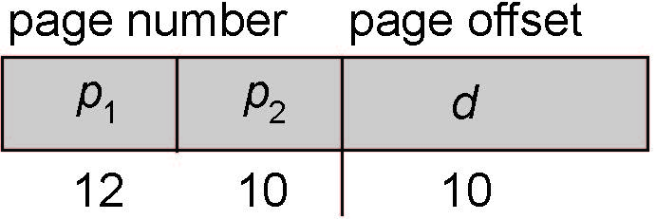
Two-Level Paging Example
A logical address (on 32-bit machine with 1K page size) is divided into:
a page number consisting of 22 bits
a page offset consisting of 10 bits
Since the page table is paged, the page number is further divided into:
a 12-bit page number
a 10-bit page offset
Thus, a logical address is as follows:
where p₁ is an index into the outer page table, and p₂ is the displacement within the page of the inner page table
Known as forward-mapped page table

Slide 52

Address-Translation Scheme

Slide 53
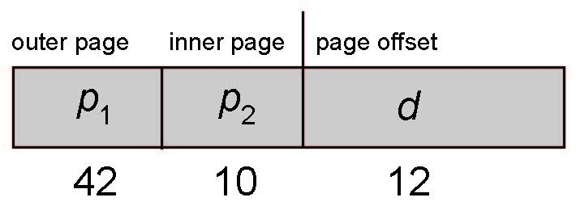
64-bit Logical Address Space
Even two-level paging scheme not sufficient
If page size is 4 KB (2¹²)
Then page table has 2⁵² entries
If two level scheme, inner page tables could be 2¹⁰ 4-byte entries
Address would look like
Outer page table has 2⁴² entries or 2⁴⁴ bytes
One solution is to add a 2nd outer page table
But in the following example the 2nd outer page table is still 2³⁴ bytes in size
And possibly 4 memory access to get to one physical memory location

Slide 54


Three-level Paging Scheme

Slide 55
Hashed Page Tables
Common in address spaces > 32 bits
The virtual page number is hashed into a page table
This page table contains a chain of elements hashing to the same location
Each element contains (1) the virtual page number (2) the value of the mapped page frame (3) a pointer to the next element
Virtual page numbers are compared in this chain searching for a match
If a match is found, the corresponding physical frame is extracted
Variation for 64-bit addresses is clustered page tables
Similar to hashed but each entry refers to several pages (such as 16) rather than 1
Especially useful for sparse address spaces (where memory references are non-contiguous and scattered)

Slide 56

Hashed Page Table

Slide 57
Inverted Page Table
Rather than each process having a page table and keeping track of all possible logical pages, track all physical pages
One entry for each real page of memory
Entry consists of the virtual address of the page stored in that real memory location, with information about the process that owns that page
Decreases memory needed to store each page table, but increases time needed to search the table when a page reference occurs
Use hash table to limit the search to one — or at most a few — page-table entries
TLB can accelerate access
But how to implement shared memory?
One mapping of a virtual address to the shared physical address

Slide 58

Inverted Page Table Architecture

Slide 59
Oracle SPARC Solaris
Consider modern, 64-bit operating system example with tightly integrated HW
Goals are efficiency, low overhead
Based on hashing, but more complex
Two hash tables
One kernel and one for all user processes
Each maps memory addresses from virtual to physical memory
Each entry represents a contiguous area of mapped virtual memory,
More efficient than having a separate hash-table entry for each page
Each entry has base address and span (indicating the number of pages the entry represents)

Slide 60
Oracle SPARC Solaris (Cont.)
TLB holds translation table entries (TTEs) for fast hardware lookups
A cache of TTEs reside in a translation storage buffer (TSB)
Includes an entry per recently accessed page
Virtual address reference causes TLB search
If miss, hardware walks the in-memory TSB looking for the TTE corresponding to the address
If match found, the CPU copies the TSB entry into the TLB and translation completes
If no match found, kernel interrupted to search the hash table
The kernel then creates a TTE from the appropriate hash table and stores it in the TSB, Interrupt handler returns control to the MMU, which completes the address translation.

Slide 61
Example: The Intel 32 and 64-bit Architectures
Dominant industry chips
Pentium CPUs are 32-bit and called IA-32 architecture
Current Intel CPUs are 64-bit and called IA-64 architecture
Many variations in the chips, cover the main ideas here

Slide 62
Example: The Intel IA-32 Architecture
Supports both segmentation and segmentation with paging
Each segment can be 4 GB
Up to 16 K segments per process
Divided into two partitions
First partition of up to 8 K segments are private to process (kept in local descriptor table (LDT))
Second partition of up to 8K segments shared among all processes (kept in global descriptor table (GDT))

Slide 63
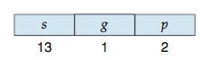
Example: The Intel IA-32 Architecture (Cont.)
CPU generates logical address
Selector given to segmentation unit
Which produces linear addresses
Linear address given to paging unit
Which generates physical address in main memory
Paging units form equivalent of MMU
Pages sizes can be 4 KB or 4 MB

Slide 64
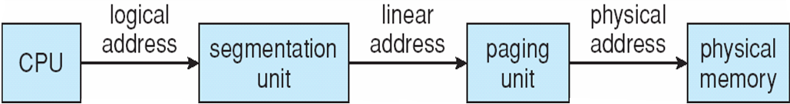
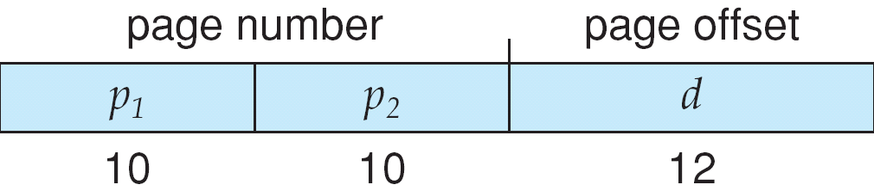
Logical to Physical Address Translation in IA-32

Slide 65
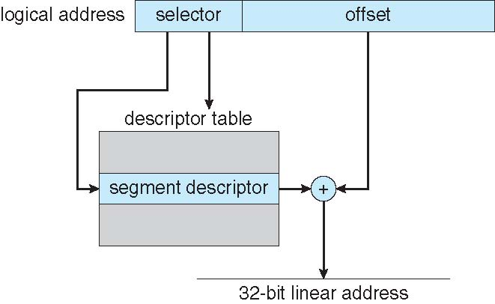
Intel IA-32 Segmentation

Slide 66
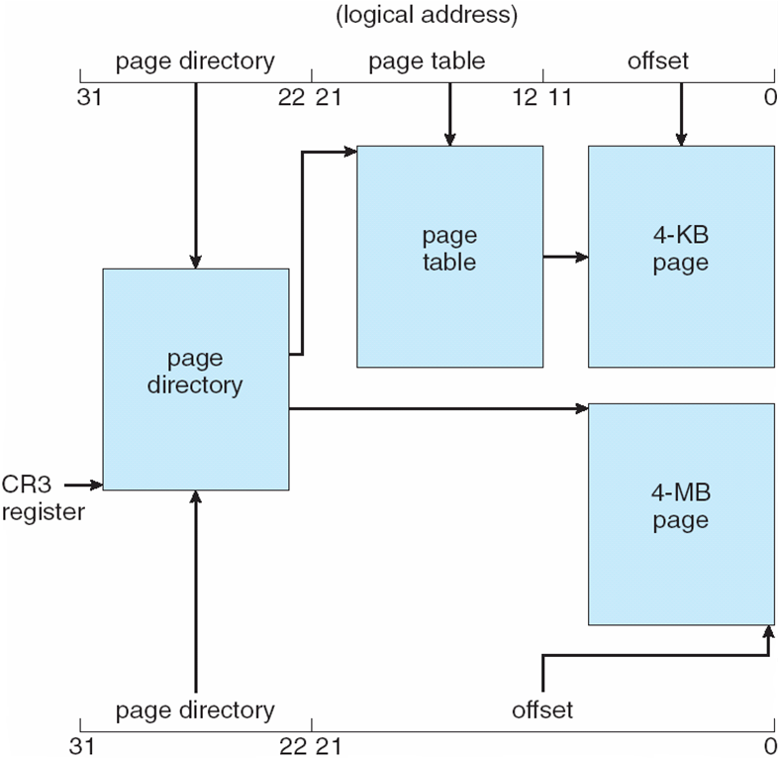
Intel IA-32 Paging Architecture

Slide 67
Intel IA-32 Page Address Extensions
32-bit address limits led Intel to create page address extension (PAE), allowing 32-bit apps access to more than 4GB of memory space
Paging went to a 3-level scheme
Top two bits refer to a page directory pointer table
Page-directory and page-table entries moved to 64-bits in size
Net effect is increasing address space to 36 bits – 64GB of physical memory

Slide 68
Intel x86-64
Current generation Intel x86 architecture
64 bits is ginormous (> 16 exabytes)
In practice only implement 48 bit addressing
Page sizes of 4 KB, 2 MB, 1 GB
Four levels of paging hierarchy
Can also use PAE so virtual addresses are 48 bits and physical addresses are 52 bits

Slide 69
Example: ARM Architecture
Dominant mobile platform chip (Apple iOS and Google Android devices for example)
Modern, energy efficient, 32-bit CPU
4 KB and 16 KB pages
1 MB and 16 MB pages (termed sections)
One-level paging for sections, two-level for smaller pages
Two levels of TLBs
Outer level has two micro TLBs (one data, one instruction)
Inner is single main TLB
First inner is checked, on miss outers are checked, and on miss page table walk performed by CPU

Slide 70
End of Chapter 8

Slide 71
Chapter 9: Virtual Memory

Slide 72
Chapter 9: Virtual Memory
Background
Demand Paging
Copy-on-Write
Page Replacement
Allocation of Frames
Thrashing
Memory-Mapped Files
Allocating Kernel Memory
Other Considerations
Operating-System Examples

Slide 73
Background
Code needs to be in memory to execute, but entire program rarely used
Error code, unusual routines, large data structures
Entire program code not needed at same time
Consider ability to execute partially-loaded program
Program no longer constrained by limits of physical memory
Each program takes less memory while running -> more programs run at the same time
Increased CPU utilization and throughput with no increase in response time or turnaround time
Less I/O needed to load or swap programs into memory -> each user program runs faster

Slide 74
Background (Cont.)
Virtual memory – separation of user logical memory from physical memory
Only part of the program needs to be in memory for execution
Logical address space can therefore be much larger than physical address space
Allows address spaces to be shared by several processes
Allows for more efficient process creation
More programs running concurrently
Less I/O needed to load or swap processes

Slide 75
Background (Cont.)
Virtual address space – logical view of how process is stored in memory
Usually start at address 0, contiguous addresses until end of space
Meanwhile, physical memory organized in page frames
MMU must map logical to physical
Virtual memory can be implemented via:
Demand paging
Demand segmentation

Slide 76
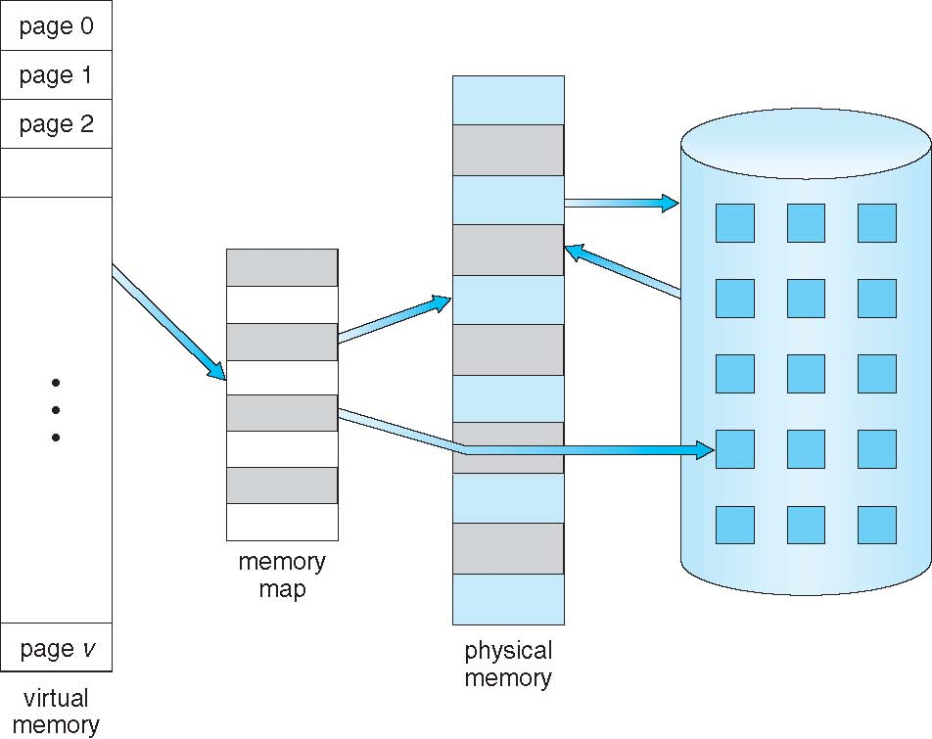
Virtual Memory That is Larger Than Physical Memory

Slide 77
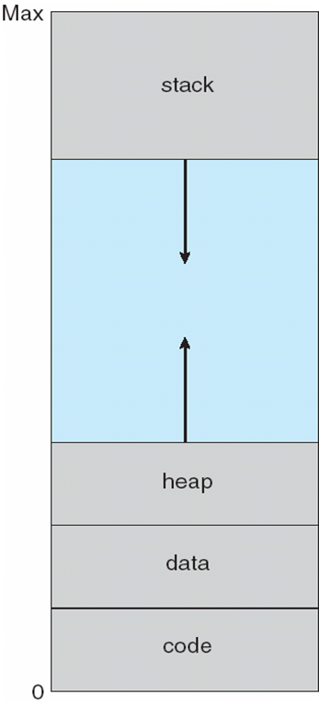
Virtual-address Space
Usually design logical address space for stack to start at Max logical address and grow “down” while heap grows “up”
Maximizes address space use
Unused address space between the two is hole
No physical memory needed until heap or stack grows to a given new page
Enables sparse address spaces with holes left for growth, dynamically linked libraries, etc
System libraries shared via mapping into virtual address space
Shared memory by mapping pages read-write into virtual address space
Pages can be shared during fork(), speeding process creation

Slide 78
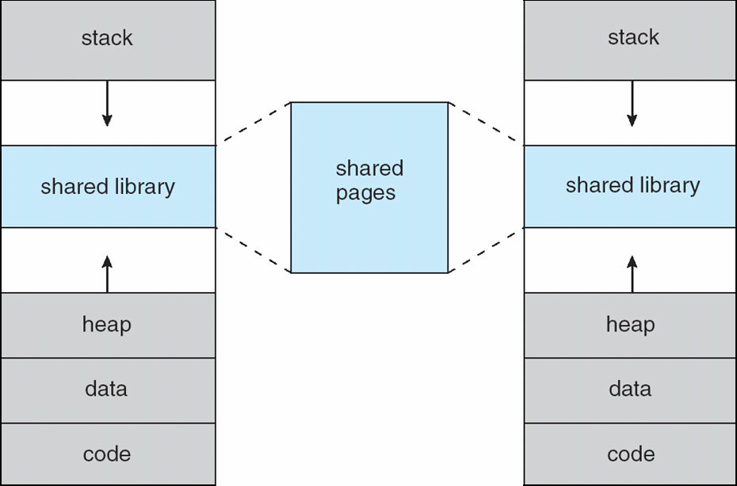
Shared Library Using Virtual Memory

Slide 79
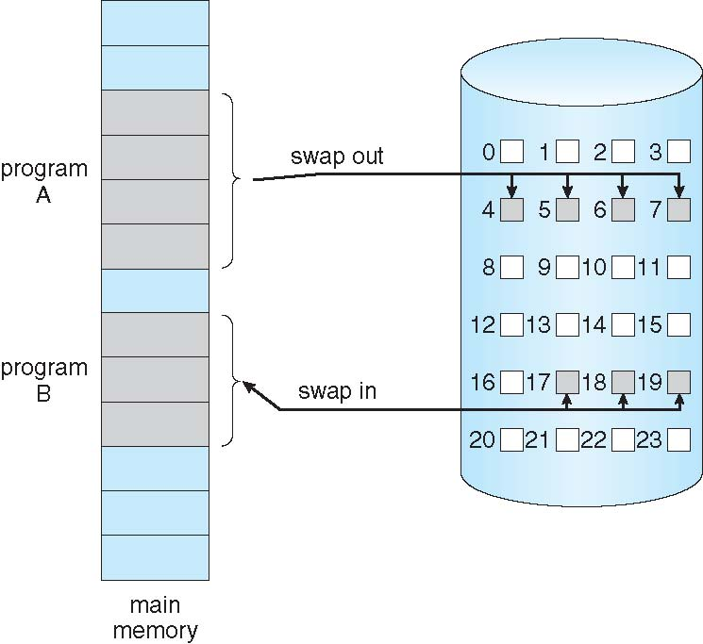
Demand Paging
Could bring entire process into memory at load time
Or bring a page into memory only when it is needed
Less I/O needed, no unnecessary I/O
Less memory needed
Faster response
More users
Similar to paging system with swapping (diagram on right)
Page is needed ⇒ reference to it
invalid reference ⇒ abort
not-in-memory ⇒ bring to memory
Lazy swapper – never swaps a page into memory unless page will be needed
Swapper that deals with pages is a pager

Slide 80
Basic Concepts
With swapping, pager guesses which pages will be used before swapping out again
Instead, pager brings in only those pages into memory
How to determine that set of pages?
Need new MMU functionality to implement demand paging
If pages needed are already memory resident
No difference from non demand-paging
If page needed and not memory resident
Need to detect and load the page into memory from storage
Without changing program behavior
Without programmer needing to change code

Slide 81
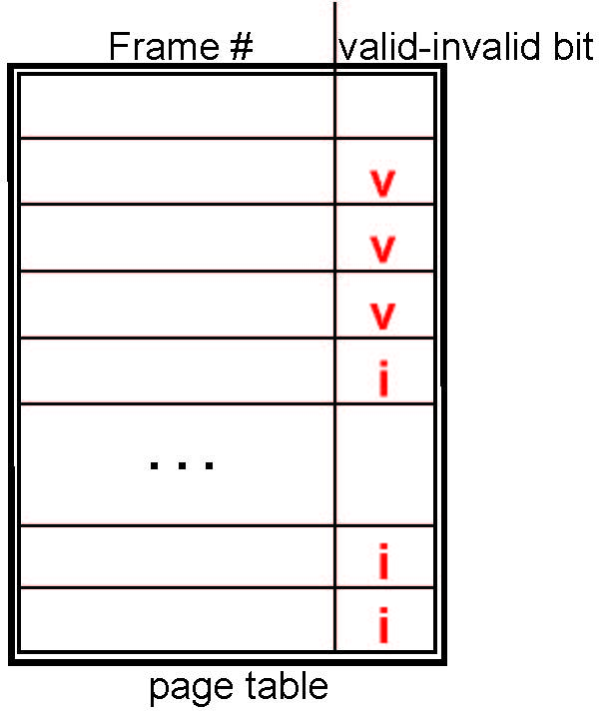
Valid-Invalid Bit
With each page table entry a valid–invalid bit is associated (v ⇒ in-memory – memory resident, i ⇒ not-in-memory)
Initially valid–invalid bit is set to i on all entries
Example of a page table snapshot:
During MMU address translation, if valid–invalid bit in page table entry is i ⇒ page fault

Slide 82
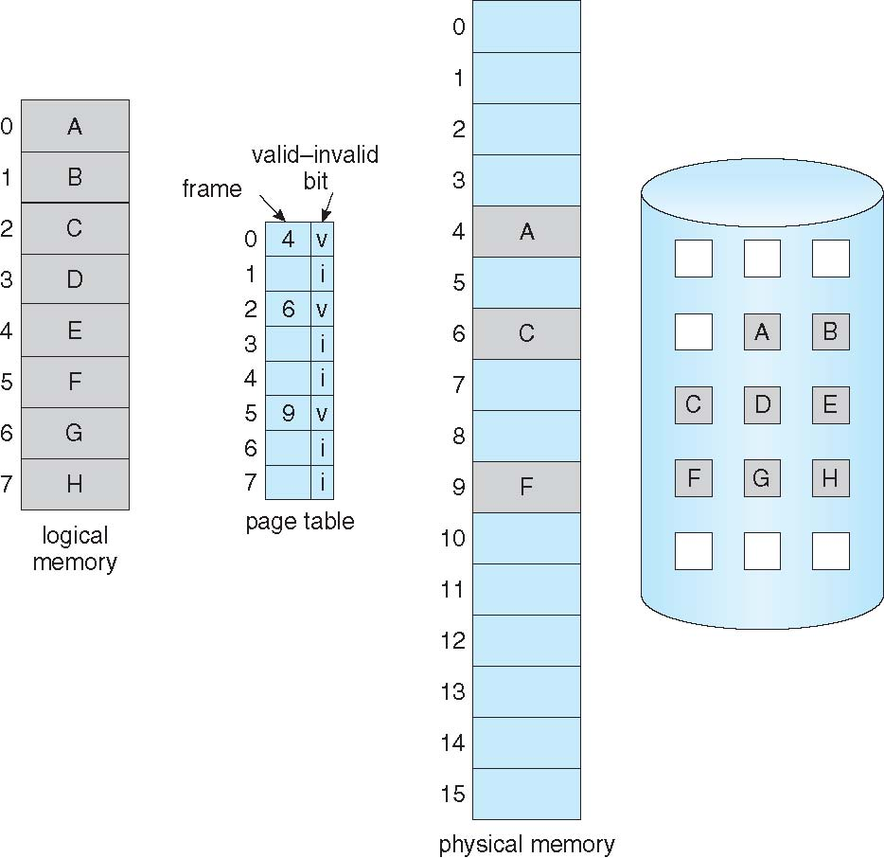
Page Table When Some Pages Are Not in Main Memory

Slide 83
Page Fault
If there is a reference to a page, first reference to that page will trap to operating system:
page fault
Operating system looks at another table to decide:
Invalid reference ⇒ abort
Just not in memory
Find free frame
Swap page into frame via scheduled disk operation
Reset tables to indicate page now in memory Set validation bit = v
Restart the instruction that caused the page fault

Slide 84

Steps in Handling a Page Fault

Slide 85
Aspects of Demand Paging
Extreme case – start process with no pages in memory
OS sets instruction pointer to first instruction of process, non-memory-resident -> page fault
And for every other process pages on first access
Pure demand paging
Actually, a given instruction could access multiple pages -> multiple page faults
Consider fetch and decode of instruction which adds 2 numbers from memory and stores result back to memory
Pain decreased because of locality of reference
Hardware support needed for demand paging
Page table with valid / invalid bit
Secondary memory (swap device with swap space)
Instruction restart

Slide 86
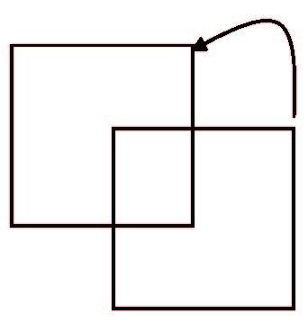
Instruction Restart
Consider an instruction that could access several different locations
block move
auto increment/decrement location
Restart the whole operation?
What if source and destination overlap?

Slide 87
Performance of Demand Paging
Stages in Demand Paging (worse case)
Trap to the operating system
Save the user registers and process state
Determine that the interrupt was a page fault
Check that the page reference was legal and determine the location of the page on the disk
Issue a read from the disk to a free frame:
Wait in a queue for this device until the read request is serviced
Wait for the device seek and/or latency time
Begin the transfer of the page to a free frame
While waiting, allocate the CPU to some other user
Receive an interrupt from the disk I/O subsystem (I/O completed)
Save the registers and process state for the other user
Determine that the interrupt was from the disk
Correct the page table and other tables to show page is now in memory
Wait for the CPU to be allocated to this process again
Restore the user registers, process state, and new page table, and then resume the interrupted instruction

Slide 88
Performance of Demand Paging (Cont.)
Three major activities
Service the interrupt – careful coding means just several hundred instructions needed
Read the page – lots of time
Restart the process – again just a small amount of time
Page Fault Rate 0 ≤ p ≤ 1
if p = 0 no page faults
if p = 1, every reference is a fault
Effective Access Time (EAT)
EAT = (1 – p) x memory access
+ p (page fault overhead
+ swap page out
+ swap page in )

Slide 89
Demand Paging Example
Memory access time = 200 nanoseconds
Average page-fault service time = 8 milliseconds
EAT = (1 – p) x 200 + p (8 milliseconds)
= (1 – p x 200 + p x 8,000,000
= 200 + p x 7,999,800
If one access out of 1,000 causes a page fault, then
EAT = 8.2 microseconds.
This is a slowdown by a factor of 40!!
If want performance degradation < 10 percent
220 > 200 + 7,999,800 x p 20 > 7,999,800 x p
p < .0000025
< one page fault in every 400,000 memory accesses

Slide 90
Demand Paging Optimizations
Swap space I/O faster than file system I/O even if on the same device
Swap allocated in larger chunks, less management needed than file system
Copy entire process image to swap space at process load time
Then page in and out of swap space
Used in older BSD Unix
Demand page in from program binary on disk, but discard rather than paging out when freeing frame
Used in Solaris and current BSD
Still need to write to swap space
Pages not associated with a file (like stack and heap) – anonymous memory
Pages modified in memory but not yet written back to the file system
Mobile systems
Typically don’t support swapping
Instead, demand page from file system and reclaim read-only pages (such as code)

Slide 91
Copy-on-Write
Copy-on-Write (COW) allows both parent and child processes to initially share the same pages in memory
If either process modifies a shared page, only then is the page copied
COW allows more efficient process creation as only modified pages are copied
In general, free pages are allocated from a pool of zero-fill-on-demand pages
Pool should always have free frames for fast demand page execution
Don’t want to have to free a frame as well as other processing on page fault
Why zero-out a page before allocating it?
vfork() variation on fork() system call has parent suspend and child using copy-on-write address space of parent
Designed to have child call exec()
Very efficient

Slide 92
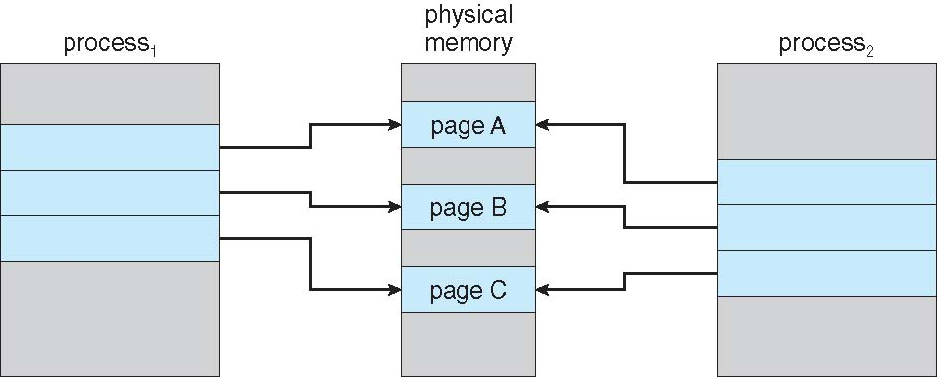
Before Process 1 Modifies Page C

Slide 93
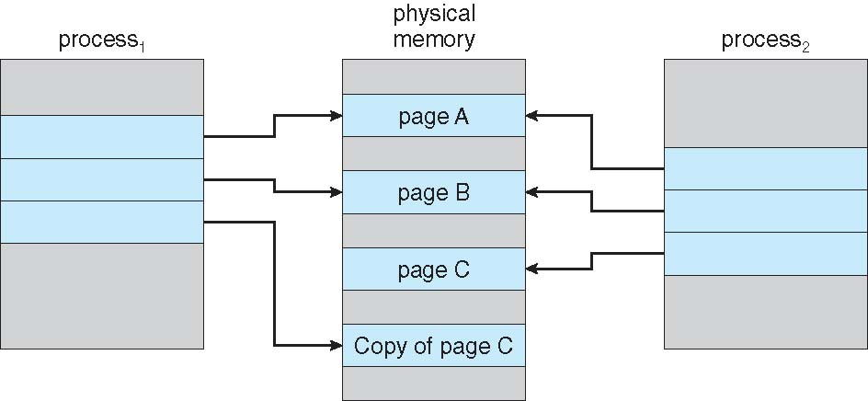
After Process 1 Modifies Page C

Slide 94
What Happens if There is no Free Frame?
Used up by process pages
Also in demand from the kernel, I/O buffers, etc
How much to allocate to each?
Page replacement – find some page in memory, but not really in use, page it out
Algorithm – terminate? swap out? replace the page?
Performance – want an algorithm which will result in minimum number of page faults
Same page may be brought into memory several times

Slide 95
Page Replacement
Prevent over-allocation of memory by modifying page-fault service routine to include page replacement
Use modify (dirty) bit to reduce overhead of page transfers – only modified pages are written to disk
Page replacement completes separation between logical memory and physical memory – large virtual memory can be provided on a smaller physical memory

Slide 96
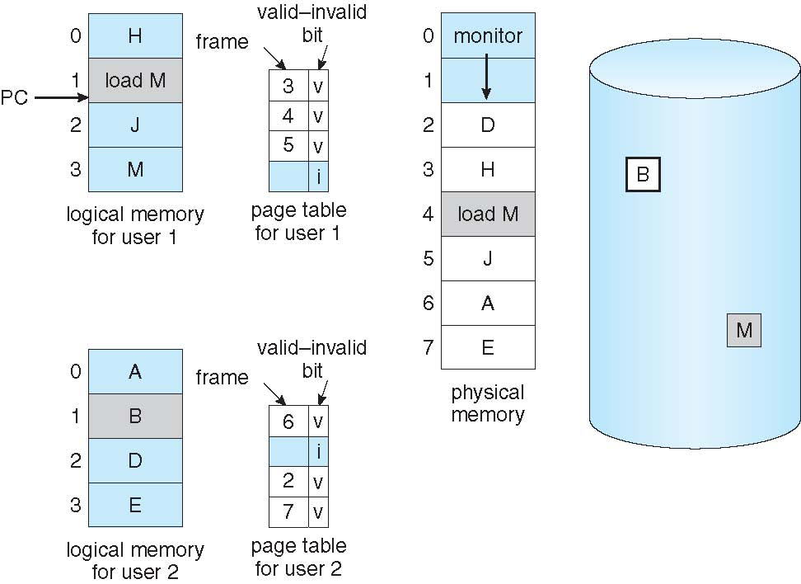
Need For Page Replacement

Slide 97
Basic Page Replacement
Find the location of the desired page on disk
Find a free frame: - If there is a free frame, use it - If there is no free frame, use a page replacement algorithm to select a victim frame - Write victim frame to disk if dirty
Bring the desired page into the (newly) free frame; update the page and frame tables
Continue the process by restarting the instruction that caused the trap
Note now potentially 2 page transfers for page fault – increasing EAT

Slide 98
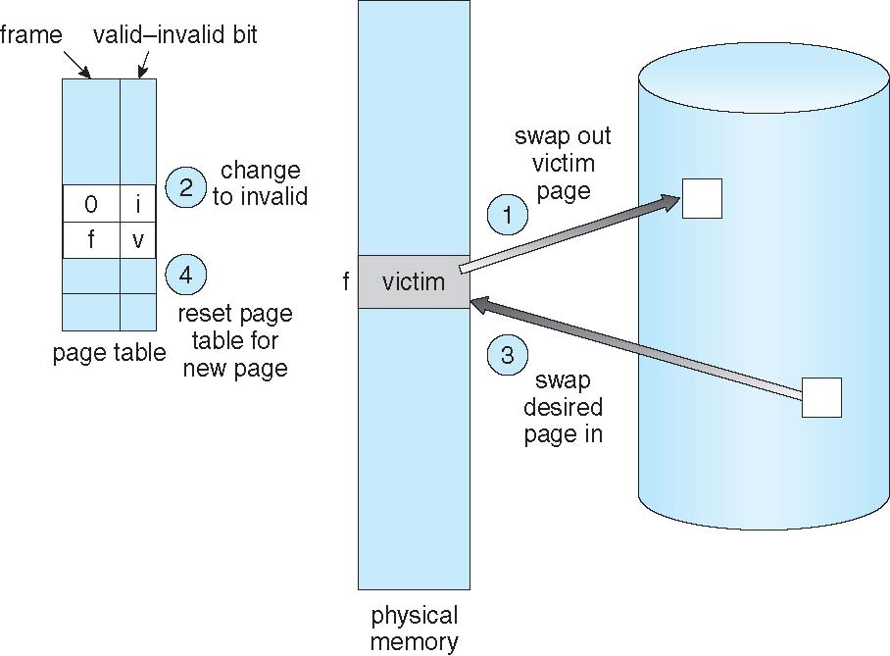
Page Replacement

Slide 99
Page and Frame Replacement Algorithms
Frame-allocation algorithm determines
How many frames to give each process
Which frames to replace
Page-replacement algorithm
Want lowest page-fault rate on both first access and re-access
Evaluate algorithm by running it on a particular string of memory references (reference string) and computing the number of page faults on that string
String is just page numbers, not full addresses
Repeated access to the same page does not cause a page fault
Results depend on number of frames available
In all our examples, the reference string of referenced page numbers is
7,0,1,2,0,3,0,4,2,3,0,3,0,3,2,1,2,0,1,7,0,1

Slide 100
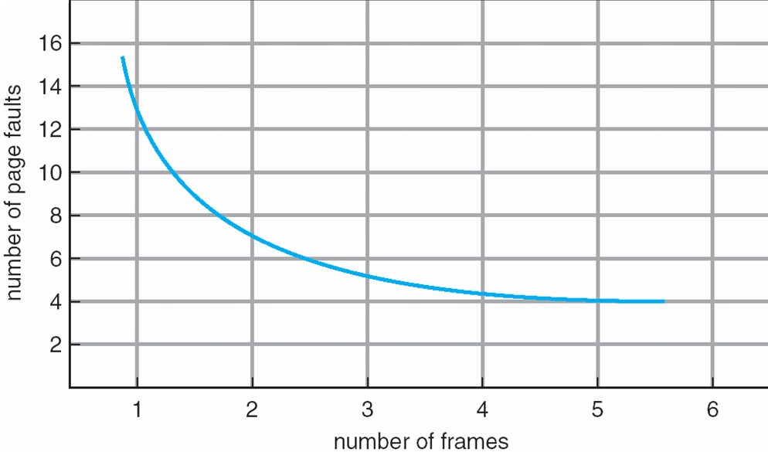
Graph of Page Faults Versus The Number of Frames

Slide 101
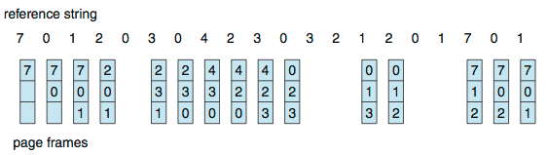
First-In-First-Out (FIFO) Algorithm
Reference string: 7,0,1,2,0,3,0,4,2,3,0,3,0,3,2,1,2,0,1,7,0,1
3 frames (3 pages can be in memory at a time per process)
Can vary by reference string: consider 1,2,3,4,1,2,5,1,2,3,4,5
Adding more frames can cause more page faults!
Belady’s Anomaly
How to track ages of pages?
Just use a FIFO queue
15 page faults

Slide 102
FIFO Illustrating Belady’s Anomaly

Slide 103
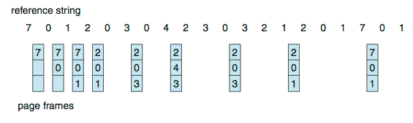
Optimal Algorithm
Replace page that will not be used for longest period of time
9 is optimal for the example
How do you know this?
Can’t read the future
Used for measuring how well your algorithm performs

Slide 104
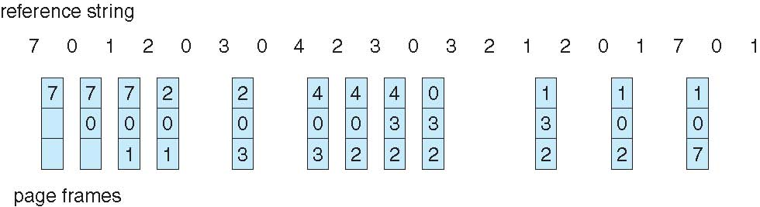
Least Recently Used (LRU) Algorithm
Use past knowledge rather than future
Replace page that has not been used in the most amount of time
Associate time of last use with each page
12 faults – better than FIFO but worse than OPT
Generally good algorithm and frequently used
But how to implement?

Slide 105
LRU Algorithm (Cont.)
Counter implementation
Every page entry has a counter; every time page is referenced through this entry, copy the clock into the counter
When a page needs to be changed, look at the counters to find smallest value
Search through table needed
Stack implementation
Keep a stack of page numbers in a double link form:
Page referenced:
move it to the top
requires 6 pointers to be changed
But each update more expensive
No search for replacement
LRU and OPT are cases of stack algorithms that don’t have Belady’s Anomaly

Slide 106
Use Of A Stack to Record Most Recent Page References

Slide 107
LRU Approximation Algorithms
LRU needs special hardware and still slow
Reference bit
With each page associate a bit, initially = 0
When page is referenced bit set to 1
Replace any with reference bit = 0 (if one exists)
We do not know the order, however
Second-chance algorithm
Generally FIFO, plus hardware-provided reference bit
Clock replacement
If page to be replaced has
Reference bit = 0 -> replace it
reference bit = 1 then:
set reference bit 0, leave page in memory
replace next page, subject to same rules

Slide 108
Second-Chance (clock) Page-Replacement Algorithm

Slide 109
Enhanced Second-Chance Algorithm
Improve algorithm by using reference bit and modify bit (if available) in concert
Take ordered pair (reference, modify)
(0, 0) neither recently used not modified – best page to replace
(0, 1) not recently used but modified – not quite as good, must write out before replacement
(1, 0) recently used but clean – probably will be used again soon
(1, 1) recently used and modified – probably will be used again soon and need to write out before replacement
When page replacement called for, use the clock scheme but use the four classes replace page in lowest non-empty class
Might need to search circular queue several times

Slide 110
Counting Algorithms
Keep a counter of the number of references that have been made to each page
Not common
Lease Frequently Used (LFU) Algorithm: replaces page with smallest count
Most Frequently Used (MFU) Algorithm: based on the argument that the page with the smallest count was probably just brought in and has yet to be used

Slide 111
Page-Buffering Algorithms
Keep a pool of free frames, always
Then frame available when needed, not found at fault time
Read page into free frame and select victim to evict and add to free pool
When convenient, evict victim
Possibly, keep list of modified pages
When backing store otherwise idle, write pages there and set to non-dirty
Possibly, keep free frame contents intact and note what is in them
If referenced again before reused, no need to load contents again from disk
Generally useful to reduce penalty if wrong victim frame selected

Slide 112
Applications and Page Replacement
All of these algorithms have OS guessing about future page access
Some applications have better knowledge – i.e. databases
Memory intensive applications can cause double buffering
OS keeps copy of page in memory as I/O buffer
Application keeps page in memory for its own work
Operating system can given direct access to the disk, getting out of the way of the applications
Raw disk mode
Bypasses buffering, locking, etc

Slide 113
Allocation of Frames
Each process needs minimum number of frames
Example: IBM 370 – 6 pages to handle SS MOVE instruction:
instruction is 6 bytes, might span 2 pages
2 pages to handle from
2 pages to handle to
Maximum of course is total frames in the system
Two major allocation schemes
fixed allocation
priority allocation
Many variations

Slide 114
Fixed Allocation
Equal allocation – For example, if there are 100 frames (after allocating frames for the OS) and 5 processes, give each process 20 frames
Keep some as free frame buffer pool
Proportional allocation – Allocate according to the size of process
Dynamic as degree of multiprogramming, process sizes change

Slide 115
Priority Allocation
Use a proportional allocation scheme using priorities rather than size
If process P_{i} generates a page fault,
select for replacement one of its frames
select for replacement a frame from a process with lower priority number

Slide 116
Global vs. Local Allocation
Global replacement – process selects a replacement frame from the set of all frames; one process can take a frame from another
But then process execution time can vary greatly
But greater throughput so more common
Local replacement – each process selects from only its own set of allocated frames
More consistent per-process performance
But possibly underutilized memory

Slide 117
Non-Uniform Memory Access
So far all memory accessed equally
Many systems are NUMA – speed of access to memory varies
Consider system boards containing CPUs and memory, interconnected over a system bus
Optimal performance comes from allocating memory “close to” the CPU on which the thread is scheduled
And modifying the scheduler to schedule the thread on the same system board when possible
Solved by Solaris by creating lgroups
Structure to track CPU / Memory low latency groups
Used my schedule and pager
When possible schedule all threads of a process and allocate all memory for that process within the lgroup

Slide 118
Thrashing
If a process does not have “enough” pages, the page-fault rate is very high
Page fault to get page
Replace existing frame
But quickly need replaced frame back
This leads to:
Low CPU utilization
Operating system thinking that it needs to increase the degree of multiprogramming
Another process added to the system
Thrashing ≡ a process is busy swapping pages in and out

Slide 119
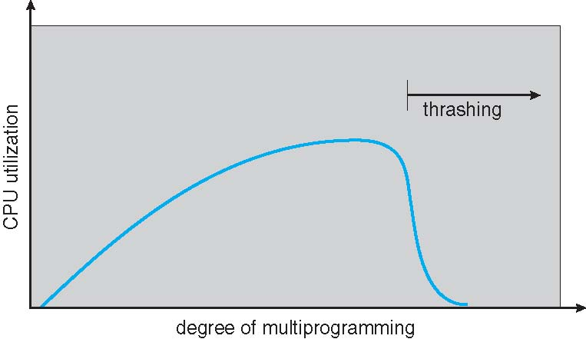
Thrashing (Cont.)

Slide 120
Demand Paging and Thrashing
Why does demand paging work? Locality model
Process migrates from one locality to another
Localities may overlap
Why does thrashing occur? Σ size of locality > total memory size
Limit effects by using local or priority page replacement

Slide 121
Locality In A Memory-Reference Pattern

Slide 122
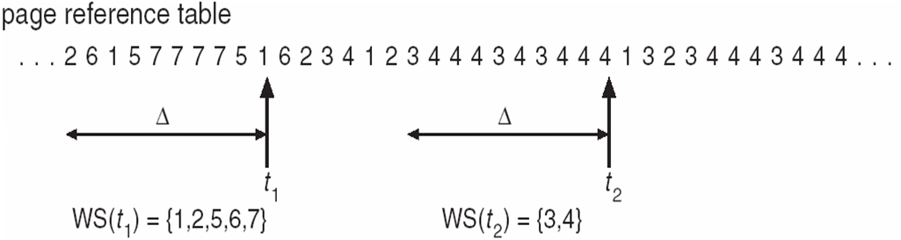
Working-Set Model
Δ ≡ working-set window ≡ a fixed number of page references Example: 10,000 instructions
WSS_{i} (working set of Process P_{i}) = total number of pages referenced in the most recent Δ (varies in time)
if Δ too small will not encompass entire locality
if Δ too large will encompass several localities
if Δ = ∞ ⇒ will encompass entire program
D = Σ WSS_{i} ≡ total demand frames
Approximation of locality
if D > m ⇒ Thrashing
Policy if D > m, then suspend or swap out one of the processes

Slide 123
Keeping Track of the Working Set
Approximate with interval timer + a reference bit
Example: Δ = 10,000
Timer interrupts after every 5000 time units
Keep in memory 2 bits for each page
Whenever a timer interrupts copy and sets the values of all reference bits to 0
If one of the bits in memory = 1 ⇒ page in working set
Why is this not completely accurate?
Improvement = 10 bits and interrupt every 1000 time units

Slide 124
Page-Fault Frequency
More direct approach than WSS
Establish “acceptable” page-fault frequency (PFF) rate and use local replacement policy
If actual rate too low, process loses frame
If actual rate too high, process gains frame

Slide 125
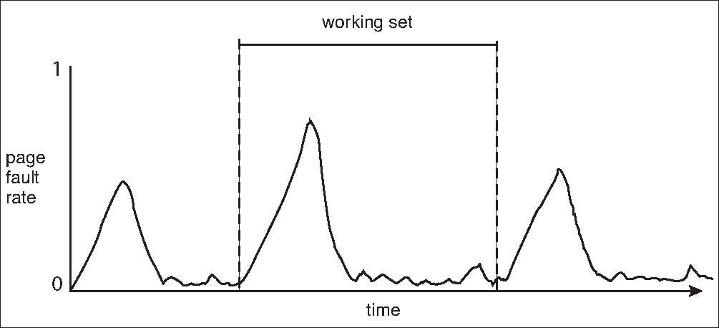
Working Sets and Page Fault Rates
Direct relationship between working set of a process and its page-fault rate
Working set changes over time
Peaks and valleys over time

Slide 126
Other Considerations -- Prepaging
Prepaging
To reduce the large number of page faults that occurs at process startup
Prepage all or some of the pages a process will need, before they are referenced
But if prepaged pages are unused, I/O and memory was wasted
Assume s pages are prepaged and α of the pages is used
Is cost of s * α save pages faults > or < than the cost of prepaging s * (1- α) unnecessary pages?
α near zero ⇒ prepaging loses

Slide 127
Other Issues – Page Size
Sometimes OS designers have a choice
Especially if running on custom-built CPU
Page size selection must take into consideration:
Fragmentation
Page table size
Resolution
I/O overhead
Number of page faults
Locality
TLB size and effectiveness
Always power of 2, usually in the range 2¹² (4,096 bytes) to 2²² (4,194,304 bytes)
On average, growing over time

Slide 128
Other Issues – TLB Reach
TLB Reach - The amount of memory accessible from the TLB
TLB Reach = (TLB Size) X (Page Size)
Ideally, the working set of each process is stored in the TLB
Otherwise there is a high degree of page faults
Increase the Page Size
This may lead to an increase in fragmentation as not all applications require a large page size
Provide Multiple Page Sizes
This allows applications that require larger page sizes the opportunity to use them without an increase in fragmentation

Slide 129
Other Issues – Program Structure
Program structure
int[128,128] data;
Each row is stored in one page
Program 1
for (j = 0; j <128; j++) for (i = 0; i < 128; i++) data[i,j] = 0;
128 x 128 = 16,384 page faults
Program 2
for (i = 0; i < 128; i++) for (j = 0; j < 128; j++) data[i,j] = 0;
128 page faults

Slide 130
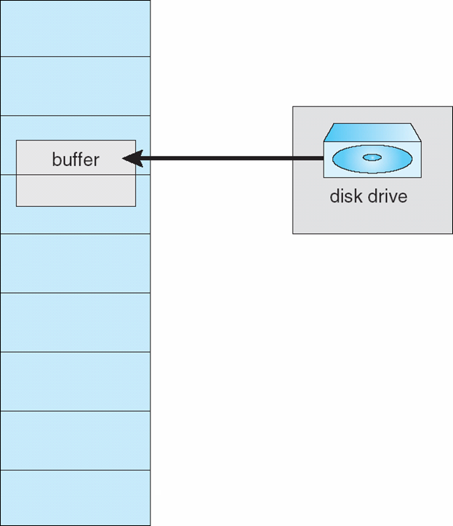
Other Issues – I/O interlock
I/O Interlock – Pages must sometimes be locked into memory
Consider I/O - Pages that are used for copying a file from a device must be locked from being selected for eviction by a page replacement algorithm
Pinning of pages to lock into memory

Slide 131
Operating System Examples
Windows
Solaris

Slide 132
Windows
Uses demand paging with clustering. Clustering brings in pages surrounding the faulting page
Processes are assigned working set minimum and working set maximum
Working set minimum is the minimum number of pages the process is guaranteed to have in memory
A process may be assigned as many pages up to its working set maximum
When the amount of free memory in the system falls below a threshold, automatic working set trimming is performed to restore the amount of free memory
Working set trimming removes pages from processes that have pages in excess of their working set minimum

Slide 133
Solaris
Maintains a list of free pages to assign faulting processes
Lotsfree – threshold parameter (amount of free memory) to begin paging
Desfree – threshold parameter to increasing paging
Minfree – threshold parameter to being swapping
Paging is performed by pageout process
Pageout scans pages using modified clock algorithm
Scanrate is the rate at which pages are scanned. This ranges from slowscan to fastscan
Pageout is called more frequently depending upon the amount of free memory available
Priority paging gives priority to process code pages

Slide 134
Solaris 2 Page Scanner

Slide 135
End of Chapter 9

Slide 136
Chapter 15: Security

Slide 137
Chapter 15: Security
The Security Problem
Program Threats
System and Network Threats
Cryptography as a Security Tool
User Authentication
Implementing Security Defenses
Firewalling to Protect Systems and Networks
Computer-Security Classifications
An Example: Windows 7

Slide 138
The Security Problem
System secure if resources used and accessed as intended under all circumstances
Unachievable
Intruders (crackers) attempt to breach security
Threat is potential security violation
Attack is attempt to breach security
Attack can be accidental or malicious
Easier to protect against accidental than malicious misuse

Slide 139
Security Violation Categories
Breach of confidentiality
Unauthorized reading of data
Breach of integrity
Unauthorized modification of data
Breach of availability
Unauthorized destruction of data
Theft of service
Unauthorized use of resources
Denial of service (DOS)
Prevention of legitimate use

Slide 140
Security Violation Methods
Masquerading (breach authentication)
Pretending to be an authorized user to escalate privileges
Replay attack
As is or with message modification
Man-in-the-middle attack
Intruder sits in data flow, masquerading as sender to receiver and vice versa
Session hijacking
Intercept an already-established session to bypass authentication

Slide 141
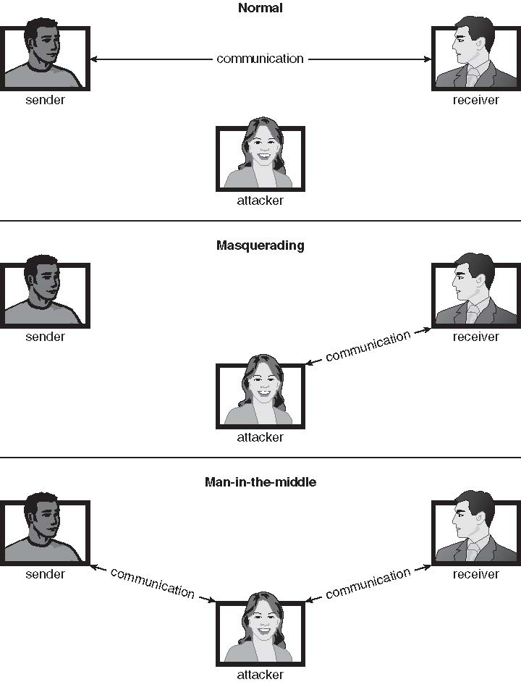
Standard Security Attacks

Slide 142
Security Measure Levels
Impossible to have absolute security, but make cost to perpetrator sufficiently high to deter most intruders
Security must occur at four levels to be effective:
Physical
Data centers, servers, connected terminals
Human
Avoid social engineering, phishing, dumpster diving
Operating System
Protection mechanisms, debugging
Network
Intercepted communications, interruption, DOS
Security is as weak as the weakest link in the chain
But can too much security be a problem?

Slide 143
Program Threats
Many variations, many names
Trojan Horse
Code segment that misuses its environment
Exploits mechanisms for allowing programs written by users to be executed by other users
Spyware, pop-up browser windows, covert channels
Up to 80% of spam delivered by spyware-infected systems
Trap Door
Specific user identifier or password that circumvents normal security procedures
Could be included in a compiler
How to detect them?

Slide 144
Program Threats (Cont.)
Logic Bomb
Program that initiates a security incident under certain circumstances
Stack and Buffer Overflow
Exploits a bug in a program (overflow either the stack or memory buffers)
Failure to check bounds on inputs, arguments
Write past arguments on the stack into the return address on stack
When routine returns from call, returns to hacked address
Pointed to code loaded onto stack that executes malicious code
Unauthorized user or privilege escalation

Slide 145
C Program with Buffer-overflow Condition
#include <stdio.h>
#define BUFFER SIZE 256
int main(int argc, char *argv[])
{
char buffer[BUFFER SIZE];
if (argc < 2)
return -1;
else {
strcpy(buffer,argv[1]);
return 0;
}
}

Slide 146
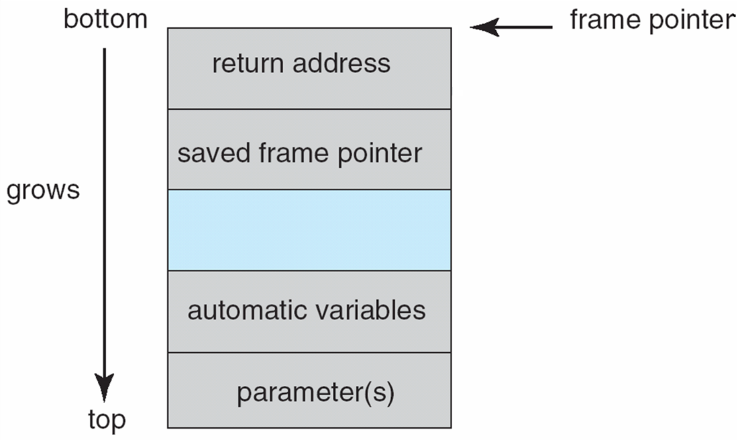
Layout of Typical Stack Frame

Slide 147
Modified Shell Code
#include <stdio.h>
int main(int argc, char *argv[])
{
execvp(‘‘\bin\sh’’,‘‘\bin \sh’’, NULL);
return 0;
}

Slide 148
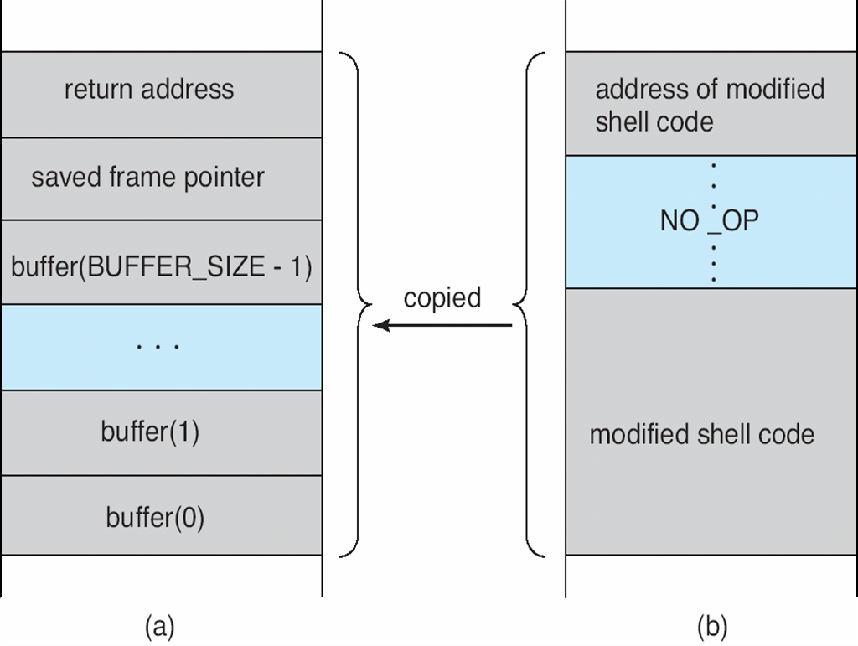
Hypothetical Stack Frame
Before attack
After attack

Slide 149
Great Programming Required?
For the first step of determining the bug, and second step of writing exploit code, yes
Script kiddies can run pre-written exploit code to attack a given system
Attack code can get a shell with the processes’ owner’s permissions
Or open a network port, delete files, download a program, etc
Depending on bug, attack can be executed across a network using allowed connections, bypassing firewalls
Buffer overflow can be disabled by disabling stack execution or adding bit to page table to indicate “non-executable” state
Available in SPARC and x86
But still have security exploits

Slide 150
Program Threats (Cont.)
Viruses
Code fragment embedded in legitimate program
Self-replicating, designed to infect other computers
Very specific to CPU architecture, operating system, applications
Usually borne via email or as a macro
Visual Basic Macro to reformat hard drive
Sub AutoOpen()
Dim oFS
Set oFS = CreateObject(’’Scripting.FileSystemObject’’)
vs = Shell(’’c:command.com /k format c:’’,vbHide)
End Sub

Slide 151
Program Threats (Cont.)
Virus dropper inserts virus onto the system
Many categories of viruses, literally many thousands of viruses
File / parasitic
Boot / memory
Macro
Source code
Polymorphic to avoid having a virus signature
Encrypted
Stealth
Tunneling
Multipartite
Armored

Slide 152
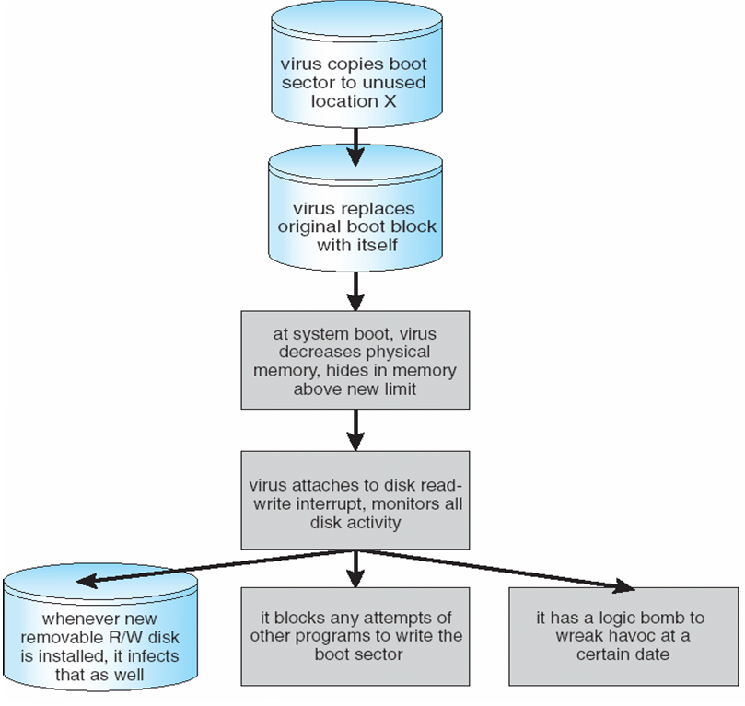
A Boot-sector Computer Virus

Slide 153
The Threat Continues
Attacks still common, still occurring
Attacks moved over time from science experiments to tools of organized crime
Targeting specific companies
Creating botnets to use as tool for spam and DDOS delivery
Keystroke logger to grab passwords, credit card numbers
Why is Windows the target for most attacks?
Most common
Everyone is an administrator
Licensing required?
Monoculture considered harmful

Slide 154
System and Network Threats
Some systems “open” rather than secure by default
Reduce attack surface
But harder to use, more knowledge needed to administer
Network threats harder to detect, prevent
Protection systems weaker
More difficult to have a shared secret on which to base access
No physical limits once system attached to internet
Or on network with system attached to internet
Even determining location of connecting system difficult
IP address is only knowledge

Slide 155
System and Network Threats (Cont.)
Worms – use spawn mechanism; standalone program
Internet worm
Exploited UNIX networking features (remote access) and bugs in finger and sendmail programs
Exploited trust-relationship mechanism used by rsh to access friendly systems without use of password
Grappling hook program uploaded main worm program
99 lines of C code
Hooked system then uploaded main code, tried to attack connected systems
Also tried to break into other users accounts on local system via password guessing
If target system already infected, abort, except for every 7th time

Slide 156
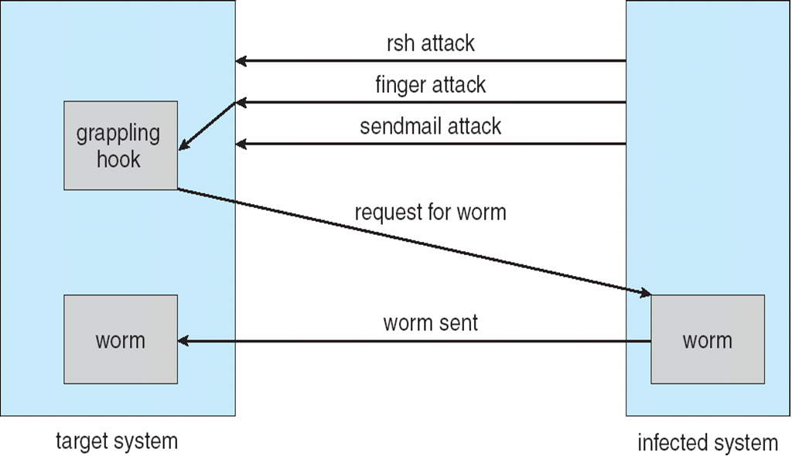
The Morris Internet Worm

Slide 157
System and Network Threats (Cont.)
Port scanning
Automated attempt to connect to a range of ports on one or a range of IP addresses
Detection of answering service protocol
Detection of OS and version running on system
nmap scans all ports in a given IP range for a response
nessus has a database of protocols and bugs (and exploits) to apply against a system
Frequently launched from zombie systems
To decrease trace-ability

Slide 158
System and Network Threats (Cont.)
Denial of Service
Overload the targeted computer preventing it from doing any useful work
Distributed denial-of-service (DDOS) come from multiple sites at once
Consider the start of the IP-connection handshake (SYN)
How many started-connections can the OS handle?
Consider traffic to a web site
How can you tell the difference between being a target and being really popular?
Accidental – CS students writing bad fork() code
Purposeful – extortion, punishment

Slide 159
Sobig.F Worm
More modern example
Disguised as a photo uploaded to adult newsgroup via account created with stolen credit card
Targeted Windows systems
Had own SMTP engine to mail itself as attachment to everyone in infect system’s address book
Disguised with innocuous subject lines, looking like it came from someone known
Attachment was executable program that created WINPPR23.EXE in default Windows system directory Plus the Windows Registry
[HKCU\SOFTWARE\Microsoft\Windows\CurrentVersion\Run] "TrayX" = %windir%\winppr32.exe /sinc [HKLM\SOFTWARE\Microsoft\Windows\CurrentVersion\Run] "TrayX" = %windir%\winppr32.exe /sinc

Slide 160
Cryptography as a Security Tool
Broadest security tool available
Internal to a given computer, source and destination of messages can be known and protected
OS creates, manages, protects process IDs, communication ports
Source and destination of messages on network cannot be trusted without cryptography
Local network – IP address?
Consider unauthorized host added
WAN / Internet – how to establish authenticity
Not via IP address

Slide 161
Cryptography
Means to constrain potential senders (sources) and / or receivers (destinations) of messages
Based on secrets (keys)
Enables
Confirmation of source
Receipt only by certain destination
Trust relationship between sender and receiver

Slide 162
Encryption
Constrains the set of possible receivers of a message
Encryption algorithm consists of
Set K of keys
Set M of Messages
Set C of ciphertexts (encrypted messages)
A function E : K → (M→C). That is, for each k ∈ K, E_{k} is a function for generating ciphertexts from messages
Both E and E_{k} for any k should be efficiently computable functions
A function D : K → (C → M). That is, for each k ∈ K, D_{k} is a function for generating messages from ciphertexts
Both D and D_{k} for any k should be efficiently computable functions

Slide 163
Encryption (Cont.)
An encryption algorithm must provide this essential property: Given a ciphertext c ∈ C, a computer can compute m such that E_{k}(m) = c only if it possesses k
Thus, a computer holding k can decrypt ciphertexts to the plaintexts used to produce them, but a computer not holding k cannot decrypt ciphertexts
Since ciphertexts are generally exposed (for example, sent on the network), it is important that it be infeasible to derive k from the ciphertexts

Slide 164
Symmetric Encryption
Same key used to encrypt and decrypt
Therefore k must be kept secret
DES was most commonly used symmetric block-encryption algorithm (created by US Govt)
Encrypts a block of data at a time
Keys too short so now considered insecure
Triple-DES considered more secure
Algorithm used 3 times using 2 or 3 keys
For example
2001 NIST adopted new block cipher - Advanced Encryption Standard (AES)
Keys of 128, 192, or 256 bits, works on 128 bit blocks
RC4 is most common symmetric stream cipher, but known to have vulnerabilities
Encrypts/decrypts a stream of bytes (i.e., wireless transmission)
Key is a input to pseudo-random-bit generator
Generates an infinite keystream

Slide 165
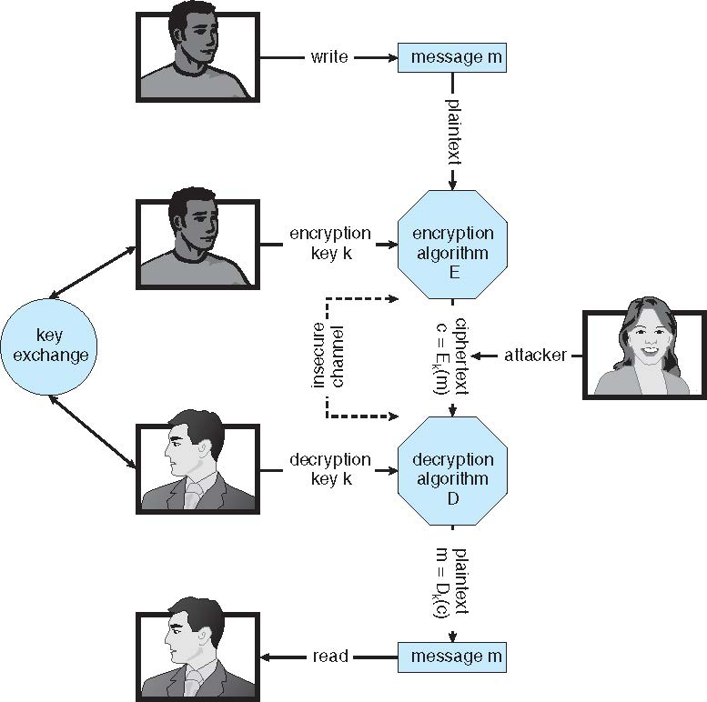
Secure Communication over Insecure Medium

Slide 166
Asymmetric Encryption
Public-key encryption based on each user having two keys:
public key – published key used to encrypt data
private key – key known only to individual user used to decrypt data
Must be an encryption scheme that can be made public without making it easy to figure out the decryption scheme
Most common is RSA block cipher
Efficient algorithm for testing whether or not a number is prime
No efficient algorithm is know for finding the prime factors of a number

Slide 167
Asymmetric Encryption (Cont.)
Formally, it is computationally infeasible to derive k_{d,N} from k_{e,N}, and so k_{e} need not be kept secret and can be widely disseminated
k_{e} is the public key
k_{d} is the private key
N is the product of two large, randomly chosen prime numbers p and q (for example, p and q are 512 bits each)
Encryption algorithm is E_{ke,N}(m) = m^{ke} mod N, where k_{e} satisfies k_{e}k_{d} mod (p−1)(q −1) = 1
The decryption algorithm is then D_{kd,N}(c) = c^{kd} mod N

Slide 168
Asymmetric Encryption Example
For example. make p = 7and q = 13
We then calculate N = 7∗13 = 91 and (p−1)(q−1) = 72
We next select k_{e} relatively prime to 72 and< 72, yielding 5
Finally, we calculate k_{d} such that k_{e}k_{d} mod 72 = 1, yielding 29
We how have our keys
Public key, k_{e,N} = 5, 91
Private key, k_{d,N} = 29, 91
Encrypting the message 69 with the public key results in the cyphertext 62
Cyphertext can be decoded with the private key
Public key can be distributed in cleartext to anyone who wants to communicate with holder of public key

Slide 169
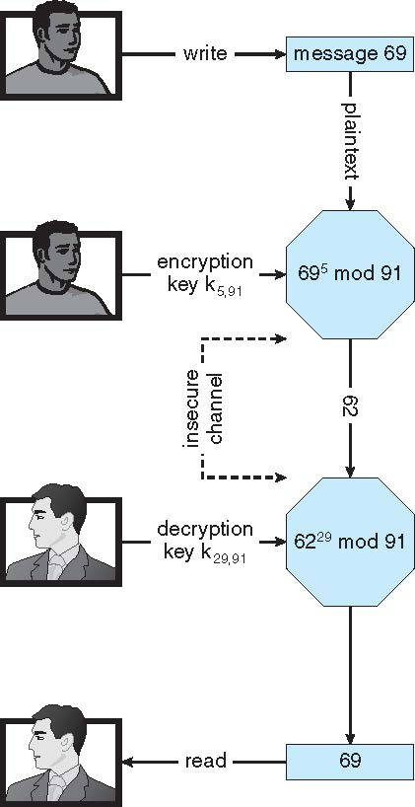
Encryption using RSA Asymmetric Cryptography

Slide 170
Cryptography (Cont.)
Note symmetric cryptography based on transformations, asymmetric based on mathematical functions
Asymmetric much more compute intensive
Typically not used for bulk data encryption

Slide 171
Authentication
Constraining set of potential senders of a message
Complementary to encryption
Also can prove message unmodified
Algorithm components
A set K of keys
A set M of messages
A set A of authenticators
A function S : K → (M→ A)
That is, for each k ∈ K, S_{k} is a function for generating authenticators from messages
Both S and S_{k} for any k should be efficiently computable functions
A function V : K → (M × A→ {true, false}). That is, for each k ∈ K, V_{k} is a function for verifying authenticators on messages
Both V and V_{k} for any k should be efficiently computable functions

Slide 172
Authentication (Cont.)
For a message m, a computer can generate an authenticator a ∈ A such that V_{k}(m, a) = true only if it possesses k
Thus, computer holding k can generate authenticators on messages so that any other computer possessing k can verify them
Computer not holding k cannot generate authenticators on messages that can be verified using V_{k}
Since authenticators are generally exposed (for example, they are sent on the network with the messages themselves), it must not be feasible to derive k from the authenticators
Practically, if V_{k}(m,a) = true then we know m has not been modified and that send of message has k
If we share k with only one entity, know where the message originated

Slide 173
Authentication – Hash Functions
Basis of authentication
Creates small, fixed-size block of data message digest (hash value) from m
Hash Function H must be collision resistant on m
Must be infeasible to find an m’ ≠ m such that H(m) = H(m’)
If H(m) = H(m’), then m = m’
The message has not been modified
Common message-digest functions include MD5, which produces a 128-bit hash, and SHA-1, which outputs a 160-bit hash
Not useful as authenticators
For example H(m) can be sent with a message
But if H is known someone could modify m to m’ and recompute H(m’) and modification not detected
So must authenticate H(m)

Slide 174
Authentication - MAC
Symmetric encryption used in message-authentication code (MAC) authentication algorithm
Cryptographic checksum generated from message using secret key
Can securely authenticate short values
If used to authenticate H(m) for an H that is collision resistant, then obtain a way to securely authenticate long message by hashing them first
Note that k is needed to compute both S_{k} and V_{k}, so anyone able to compute one can compute the other

Slide 175
Authentication – Digital Signature
Based on asymmetric keys and digital signature algorithm
Authenticators produced are digital signatures
Very useful – anyone can verify authenticity of a message
In a digital-signature algorithm, computationally infeasible to derive k_{s} from k_{v}
V is a one-way function
Thus, k_{v} is the public key and k_{s} is the private key
Consider the RSA digital-signature algorithm
Similar to the RSA encryption algorithm, but the key use is reversed
Digital signature of message S_{ks} (m) = H(m)^{ks} mod N
The key k_{s} again is a pair (d, N), where N is the product of two large, randomly chosen prime numbers p and q
Verification algorithm is V_{kv}(m, a) (a^{kv} mod N = H(m))
Where k_{v} satisfies k_{v}k_{s} mod (p − 1)(q − 1) = 1

Slide 176
Authentication (Cont.)
Why authentication if a subset of encryption?
Fewer computations (except for RSA digital signatures)
Authenticator usually shorter than message
Sometimes want authentication but not confidentiality
Signed patches et al
Can be basis for non-repudiation

Slide 177
Key Distribution
Delivery of symmetric key is huge challenge
Sometimes done out-of-band
Asymmetric keys can proliferate – stored on key ring
Even asymmetric key distribution needs care – man-in-the-middle attack

Slide 178
Digital Certificates
Proof of who or what owns a public key
Public key digitally signed a trusted party
Trusted party receives proof of identification from entity and certifies that public key belongs to entity
Certificate authority are trusted party – their public keys included with web browser distributions
They vouch for other authorities via digitally signing their keys, and so on

Slide 179
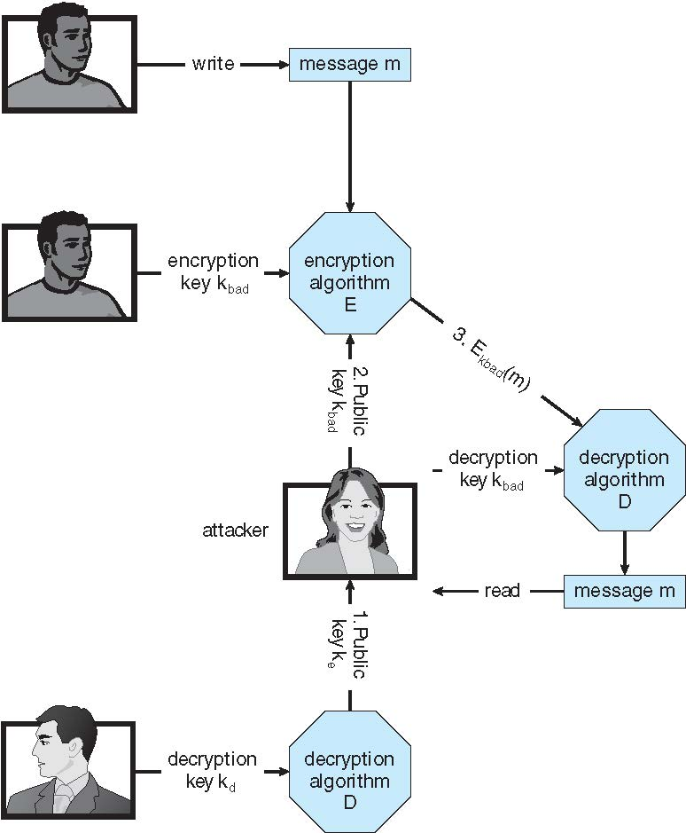
Man-in-the-middle Attack on Asymmetric Cryptography

Slide 180
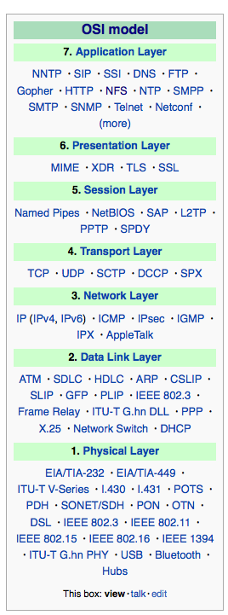
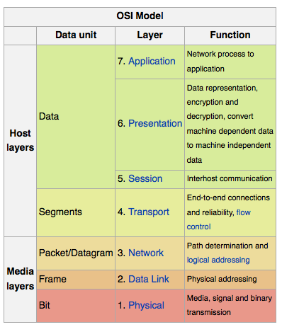
Implementation of Cryptography
Can be done at various layers of ISO Reference Model
SSL at the Transport layer
Network layer is typically IPSec
IKE for key exchange
Basis of Virtual Private Networks (VPNs)
Why not just at lowest level?
Sometimes need more knowledge than available at low levels
i.e. User authentication
i.e. e-mail delivery
Source: http://en.wikipedia.org/wiki/OSI_model

Slide 181
Encryption Example - SSL
Insertion of cryptography at one layer of the ISO network model (the transport layer)
SSL – Secure Socket Layer (also called TLS)
Cryptographic protocol that limits two computers to only exchange messages with each other
Very complicated, with many variations
Used between web servers and browsers for secure communication (credit card numbers)
The server is verified with a certificate assuring client is talking to correct server
Asymmetric cryptography used to establish a secure session key (symmetric encryption) for bulk of communication during session
Communication between each computer then uses symmetric key cryptography
More details in textbook

Slide 182
User Authentication
Crucial to identify user correctly, as protection systems depend on user ID
User identity most often established through passwords, can be considered a special case of either keys or capabilities
Passwords must be kept secret
Frequent change of passwords
History to avoid repeats
Use of “non-guessable” passwords
Log all invalid access attempts (but not the passwords themselves)
Unauthorized transfer
Passwords may also either be encrypted or allowed to be used only once
Does encrypting passwords solve the exposure problem?
Might solve sniffing
Consider shoulder surfing
Consider Trojan horse keystroke logger
How are passwords stored at authenticating site?

Slide 183
Passwords
Encrypt to avoid having to keep secret
But keep secret anyway (i.e. Unix uses superuser-only readably file /etc/shadow)
Use algorithm easy to compute but difficult to invert
Only encrypted password stored, never decrypted
Add “salt” to avoid the same password being encrypted to the same value
One-time passwords
Use a function based on a seed to compute a password, both user and computer
Hardware device / calculator / key fob to generate the password
Changes very frequently
Biometrics
Some physical attribute (fingerprint, hand scan)
Multi-factor authentication
Need two or more factors for authentication
i.e. USB “dongle”, biometric measure, and password

Slide 184
Implementing Security Defenses
Defense in depth is most common security theory – multiple layers of security
Security policy describes what is being secured
Vulnerability assessment compares real state of system / network compared to security policy
Intrusion detection endeavors to detect attempted or successful intrusions
Signature-based detection spots known bad patterns
Anomaly detection spots differences from normal behavior
Can detect zero-day attacks
False-positives and false-negatives a problem
Virus protection
Searching all programs or programs at execution for known virus patterns
Or run in sandbox so can’t damage system
Auditing, accounting, and logging of all or specific system or network activities
Practice safe computing – avoid sources of infection, download from only “good” sites, etc

Slide 185
Firewalling to Protect Systems and Networks
A network firewall is placed between trusted and untrusted hosts
The firewall limits network access between these two security domains
Can be tunneled or spoofed
Tunneling allows disallowed protocol to travel within allowed protocol (i.e., telnet inside of HTTP)
Firewall rules typically based on host name or IP address which can be spoofed
Personal firewall is software layer on given host
Can monitor / limit traffic to and from the host
Application proxy firewall understands application protocol and can control them (i.e., SMTP)
System-call firewall monitors all important system calls and apply rules to them (i.e., this program can execute that system call)

Slide 186
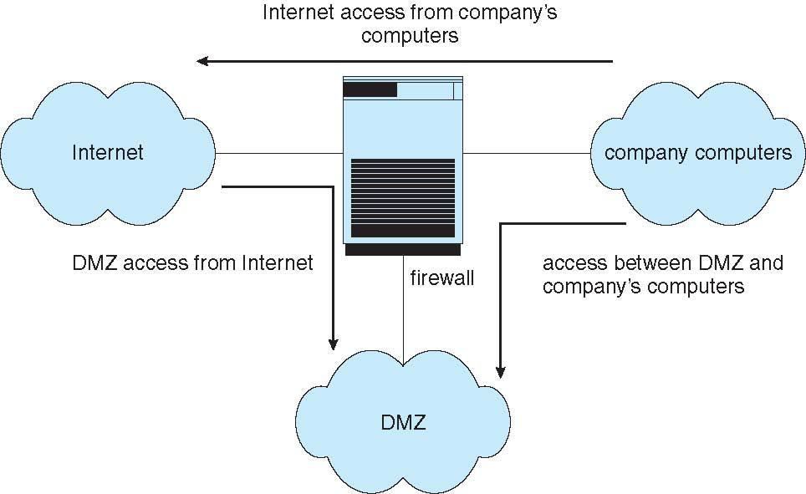
Network Security Through Domain Separation Via Firewall

Slide 187
Computer Security Classifications
U.S. Department of Defense outlines four divisions of computer security: A, B, C, and D
D – Minimal security
C – Provides discretionary protection through auditing
Divided into C1 and C2
C1 identifies cooperating users with the same level of protection
C2 allows user-level access control
B – All the properties of C, however each object may have unique sensitivity labels
Divided into B1, B2, and B3
A – Uses formal design and verification techniques to ensure security

Slide 188
Example: Windows 7
Security is based on user accounts
Each user has unique security ID
Login to ID creates security access token
Includes security ID for user, for user’s groups, and special privileges
Every process gets copy of token
System checks token to determine if access allowed or denied
Uses a subject model to ensure access security
A subject tracks and manages permissions for each program that a user runs
Each object in Windows has a security attribute defined by a security descriptor
For example, a file has a security descriptor that indicates the access permissions for all users

Slide 189
Example: Windows 7 (Cont.)
Win added mandatory integrity controls – assigns integrity label to each securable object and subject
Subject must have access requested in discretionary access-control list to gain access to object
Security attributes described by security descriptor
Owner ID, group security ID, discretionary access-control list, system access-control list

Slide 190
End of Chapter 15

